Slide 1



SalesDashboard_Production
View in Power BI
Last data refresh:
2/16/2021 11:32:08 AM Central Standard Time
Downloaded at:
2/16/2021 11:34:37 AM Central Standard Time

Slide 2
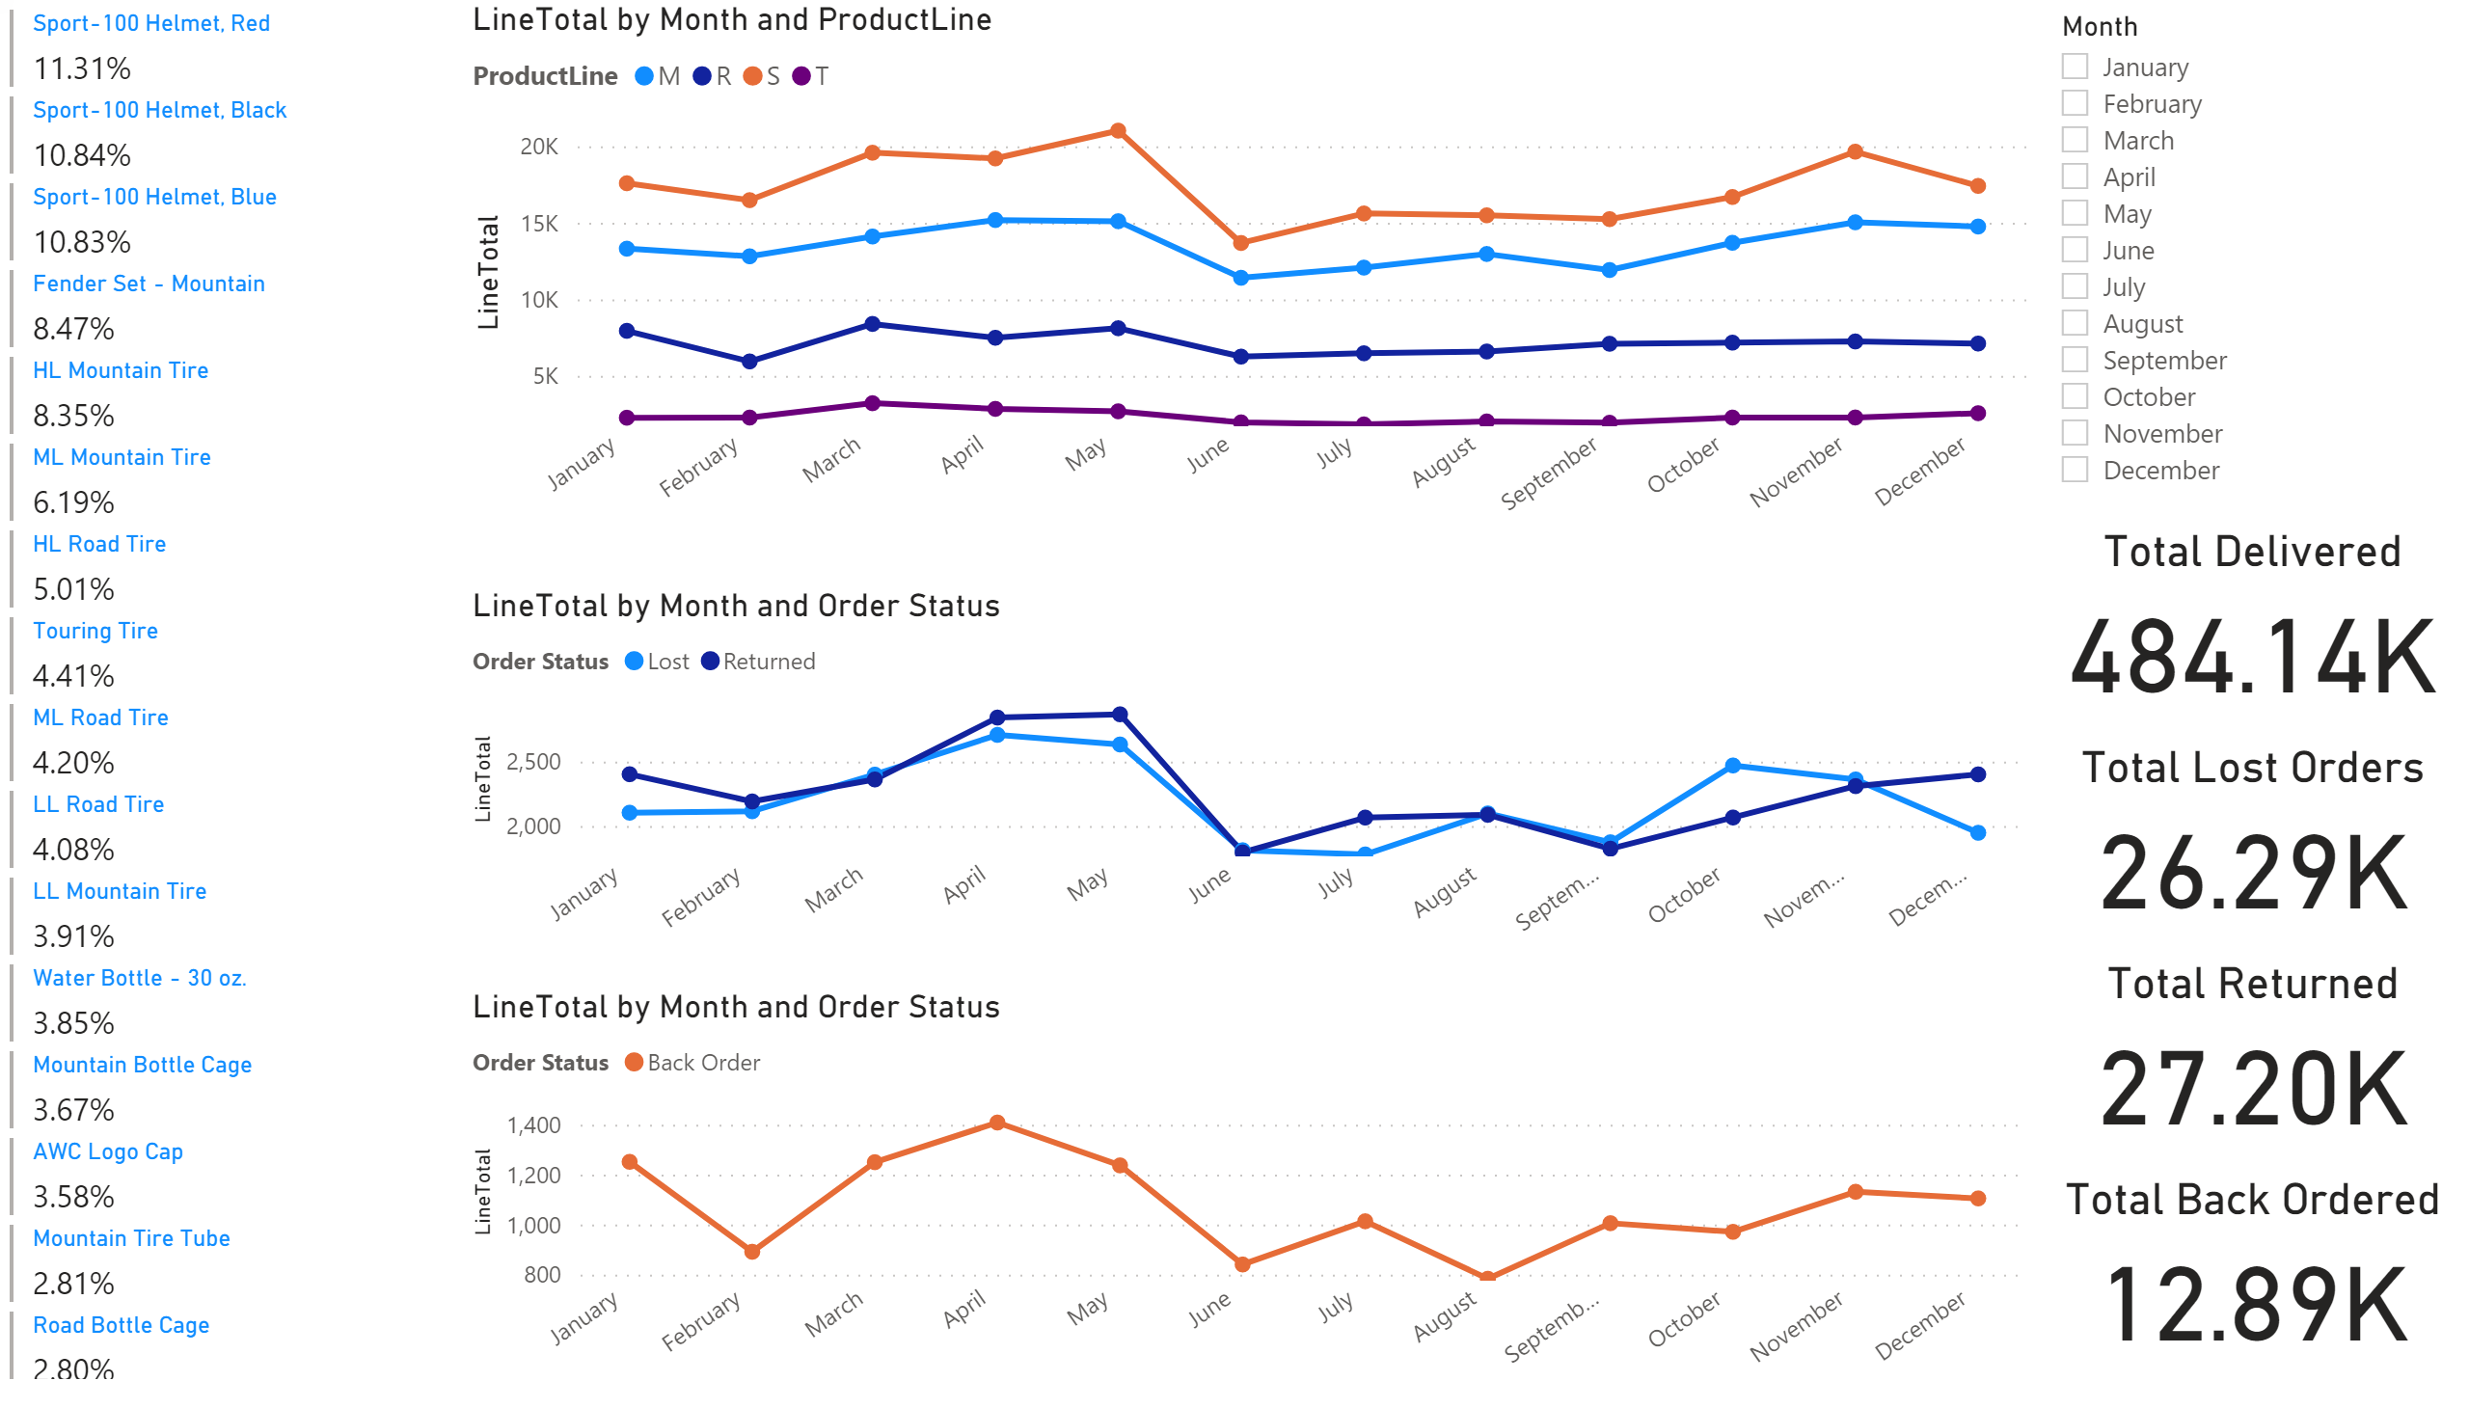
Sales Dashboard
Notes:
lineChart
No alt text provided.
lineChart
No alt text provided.
lineChart
No alt text provided.
multiRowCard
No alt text provided.
Total Delivered
No alt text provided.
Total Lost Orders
No alt text provided.
Total Returned
No alt text provided.
Total Back Ordered
No alt text provided.
slicer
No alt text provided.

Slide 3
Sales Dashboard
You can filter by each month
Notes:
lineChart
No alt text provided.
lineChart
No alt text provided.
lineChart
No alt text provided.
multiRowCard
No alt text provided.
Total Delivered
No alt text provided.
Total Lost Orders
No alt text provided.
Total Returned
No alt text provided.
Total Back Ordered
No alt text provided.
slicer
No alt text provided.

